Slide 1
Glycogen Metabolism

Slide 2
Quiz Question #1
What process is the breakdown of glycogen to glucose in the cell?
Glycogenesis
Glycogenolysis
Glycolysis
Gluconeogenesis
Notes:
Answer is B

Slide 3
Quiz Question #2
Which is most true about glycogen synthase (GS) and glycogen phosphorylase (GP) activity and phosphorylation
Phosphorylation of both GP and GS increases activity
Phosphorylation of both GP and GS decreases activity
Phosphorylation increases the activity of GS but not GP
Phosphorylation increases the activity of GP but not GS
Notes:
Answer is D

Slide 4
Quiz Question #3
Which hormone(s) promote glycogen breakdown in muscle?
Epinephrine
Glucagon
Insulin
Both A and B
Notes:
Answer is A

Slide 5
Learning Objectives
Evaluate how the structure of glycogen allows for compact but accessible storage of glucose molecules.
Understand how glycogen synthesis and glycolysis are regulated by intracellular metabolites.
Explain how protein phosphorylation regulates glycogen synthase and glycogen phosphorylase activities and how extracellular signals affect glycogen metabolism.
Assess the tissue-specific roles of insulin, adrenaline and glucagon in glycogen storage.
Distinguish between the functions of glycogen in liver, adipose and muscle and evaluate how alterations in glycogen metabolism affect the physiological functions of these tissues.
Explain how glycogen storage diseases can occur and how specific genes result in different pathophysiologies depending on both the gene, and tissue where it is expressed.

Slide 6
Glycogen Metabolism

Slide 7
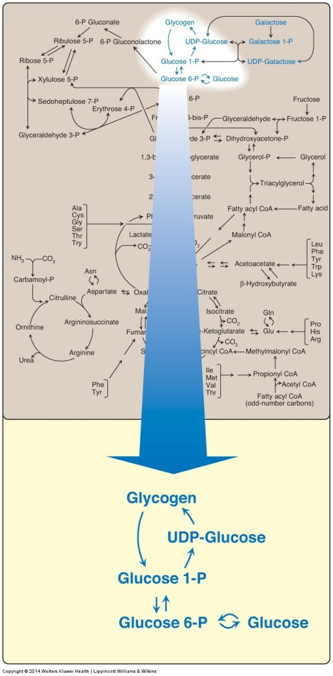
Glycogen Metabolism is Easy!
Glycogen Phosphorylase
Glycogen Synthase

Slide 8
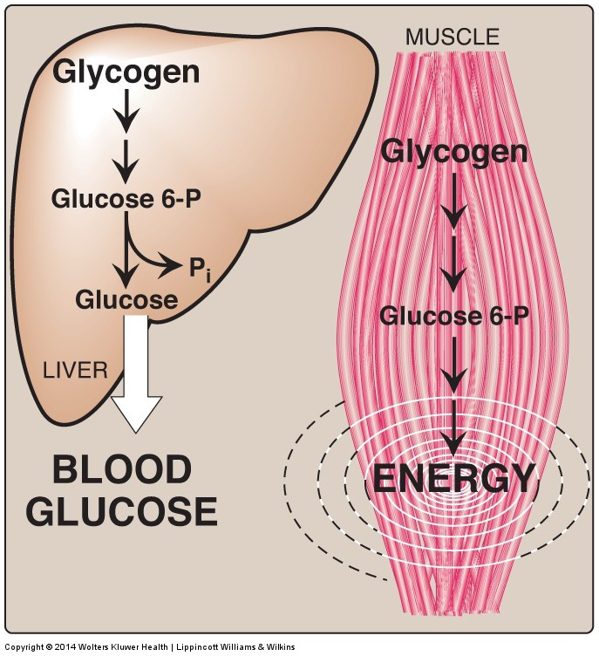
Tissue-Dependent Roles in Glycogen Metabolism
Notes:
What if G6Pase didn’t function correctly?

Slide 9
Why does liver release glucose but muscle utilizes it for energy?
Liver cannot use glucose for energy because it has no mitochondria
Liver cannot use glucose for energy because it has no PDH
Muscle cannot release glucose because of a lack of G6Pase
Muscle cannot release glucose because of a lack of GLUT4

Slide 10
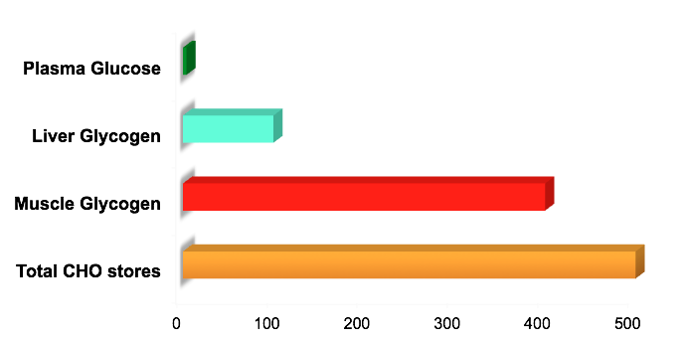
Glycogen Storage
Notes:
Wasserman, D.. Four grams of glucose. American Journal of Physiology- Endocrinology and Metabolism. 2009; 296: E11-E21.

Slide 11
Structure of Glycogen
Notes:
Why do you think there are all these branches?

Slide 12
What polysaccharide is glycogen most similar to?
Amylose
Amylopectin
Cellulose
Glucose
Notes:
Answer is B amylopectin

Slide 13
How To Remove Branch Points
This is catalyzed by a single enzyme called AGL
What are some advantages of branching?

Slide 14
Cori’s Disease
Mutations in debranching enzyme (AGL)
Single gene in all tissues, autosomal recessive
Mutations result in:
Buildup of highly branched glycogen
Hypoglycemia
Hepatomegaly (enlarged liver)
Hyperlipidemia
Poor muscle tone (hypotonia)
Muscle degeneration (myopathy)
Weakened hearts (cardiomyopathy)
Can affect muscle/liver/heart differentially, unknown why

Slide 15
GSD Activity
Guess whether glycogen levels would be higher or lower for each
At your table you have been assigned a random disease
Predict some consequences of this disease
Decide how a diet or exercise intervention may help

Slide 16
Glycogen Storage Diseases Exercise
Inventory of known variants of genes can be found at ExAC (http://exac.broadinstitute.org/)
Associations of genes to many diseases can be found at PheWeb (pheweb.sph.umich.edu)
Associations of genes to type 2 diabetes can be found at Type 2 Diabetes Knowledge Portal (http://www.type2diabetesgenetics.org)

Slide 17
Completed Table (Will Post on Canvas)
Disease | Enzyme/GENE | Glycogen Levels | Predicted Phenotypes
Fanconi-Bickel | GLUT2/SLC4A2 | Higher | Hepatomegaly (Large liver) Glucose/Galactose Intolerance Fasting Hypoglycemia Renal Nephropathy Short Stature
Von Gierke’s | G6Pase/G6PC | Higher | Lactic Acidosis Severe Hypoglycemia Hepatomegaly Short Stature Hyperlipidemia
Tarui’s | Muscle PFK1/PFKM | Higher | Muscle weakness Fatigue Cardiomyopathy
GSD Type 0 | Liver GS/GYSL | Lower | Lethargy Mental confusion, attention Growth delay Fasting hypoglycemia Elevated fasting ketones
Cori’s Disease | AGL/AGL | Higher (more branched) | Hepatomegaly Cardiomopathy Hypoglycemia Failure to thrive
Anderson’s | Branching Enzyme/GBE | Higher (less branched) | Muscle wasting Cardiomyopathy Hepatomegaly/Liver Failure
McArdle’s | Muscle Phosphorylase/PYGM | Higher in Muscle | Weakness after starting exercise but tolerance after 8-10 minutes (second wind) Muscle pain/cramping Muscle breakdown
Hers’ | Liver Phosphorylase/PYGL | Higher in Liver | Developmental delay Hepatomegaly Hypoglycemia Hyperketosis Hyperlipidemia
GSD IX | Phosphorylase Kinase/ PHKA1/2 | Higher | Developmental delay Delayed motor development Hepatomegaly Hypoglycemia Hyperketosis

Slide 18
Regulation of Glycogenolysis

Slide 19
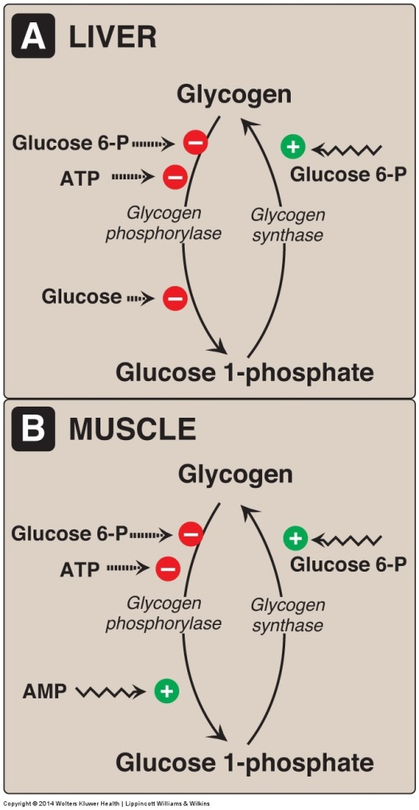
Glycogen Phosphorylase Releases Most Glucose Molecules
Note that muscle and liver have different isoforms of glycogen phosphorylase and therefore can be regulated differently.
Why are these differences advantageous?

Slide 20
Glucagon and Epinephrine
Quick review

Slide 21
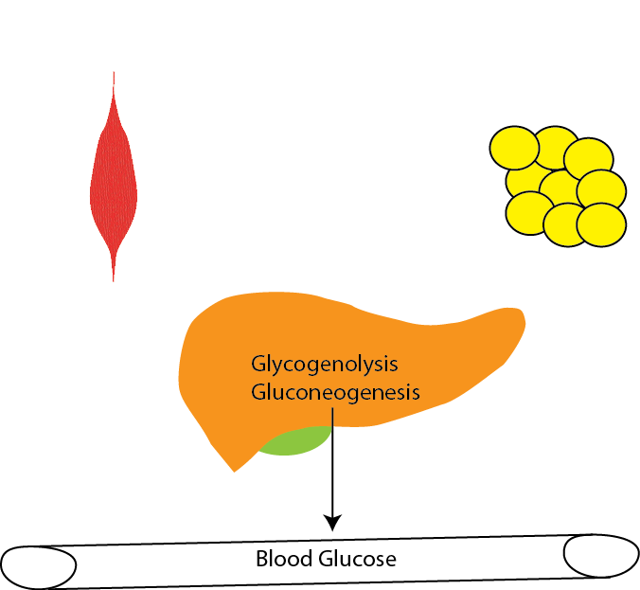
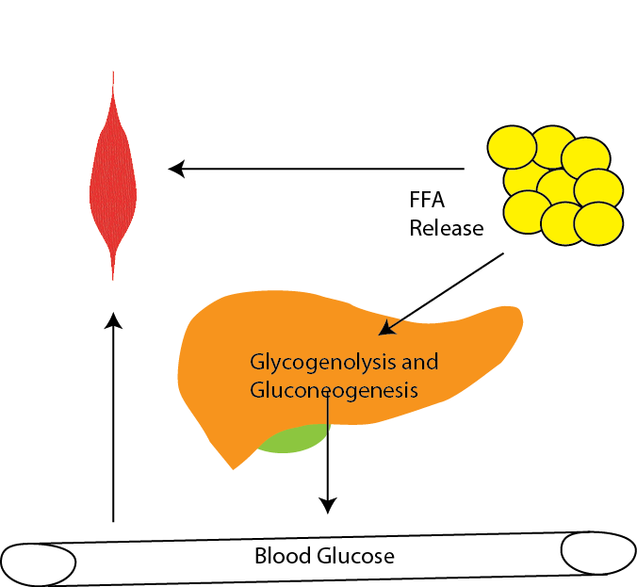
Physiology of Glucagon vs Adrenaline
Glucagon
Epinephrine
Raise Blood Glucose
Provide Glucose to Muscle

Slide 22
Adrenergic Signaling Effects on Glucose/Glycogen
Glucagon
Epinephrine
Liver
Blocks glycolysis (PFK2/PK)
Stimulates gluconeogenesis (FBPase)
Blocks glycogenesis (GS/PhA)
Stimulates glycogenolysis (GS/PhA)
Muscle/Fat
Very little effect on anything almost no Glucagon receptors
Liver
Blocks glycolysis (PFK2/PK)
Stimulates gluconeogenesis (FBPase)
Blocks glycogenesis (GS/PhA)
Stimulates glycogenolysis (GS/PhA)
Muscle/Fat
Positive effect on glycolysis
No appreciable gluconeogenesis
Blocks glycogenesis (GS/PhA)
Stimulates glycogenolysis (GS/PhA)

Slide 23
Why does adrenaline not suppress glycolysis in muscle
Muscle doesn’t have PFK-2 activity
Adrenaline does not activate PKA in muscle
Muscle PK/PFK-2 can’t be phosphorylated by PKA
There are no Adrenaline receptors in muscle
Notes:
C

Slide 24
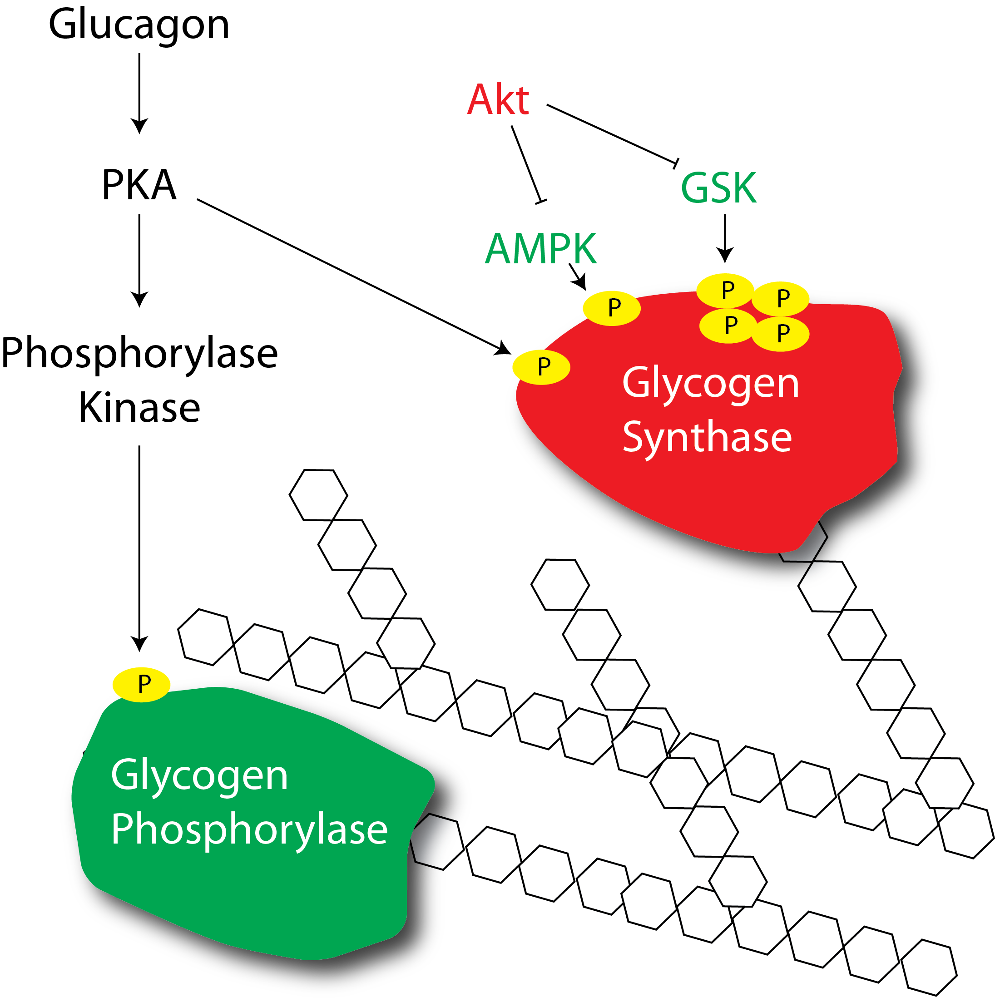
How does glucagon or adrenaline regulate glycogenolysis?

Slide 25
Defects in glycogen phosphorylase
Muscle phosphorylase
Liver phosphorylase
McArdle’s disease
Rhabdomyolysis
Second wind phenomena
Treated by high protein diets
Hers’ disease
Hypoglycemia
Hepatomegaly
Hyperlipidemia
Treated by avoiding fasting, or frequent dextrose/cornstarch feeding through the night
Notes:
Second wind is due to increased ability to use lipids and proteins as an energy source, but these take some time to mobilize (usually feel better after about 10 mins of aerobic exercise)

Slide 26
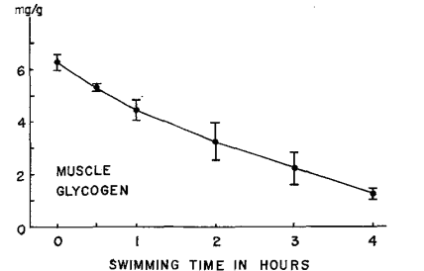
Muscle Glycogen Depletion During Exercise
Notes:
Armstrong, R., Saubert, C., Sembrowich, W., Shepherd, R., & Gollnick, P. Glycogen depletion in rat skeletal muscle fibers at different intensities and durations of exercise. Pflügers Archiv. 1974; 352: 243-256.

Slide 27
Source of Energy During Exercise
What signal do you think is driving glucose transport into muscle?
What signals do you think are breaking down glycogen
Why do you think fatty acids are not being used as much at high intensity?
Romijn, J. a et al. Regulation in relation of endogenous fat and carbohydrate to exercise intensity and duration metabolism. Endocrinol Metab 28, 380–391 (1993).
Notes:
Romijn, J., Coyle, E., Sidossis, L., Gastaldelli, A., Horowitz, J., Endert, E., & Wolfe, R. Regulation of endogenous fat and carbohydrate metabolism in relation to exercise intensity and duration. American Journal of Physiology- Endocrinology and Metabolism. 1993; 265(3): 380-91.

Slide 28
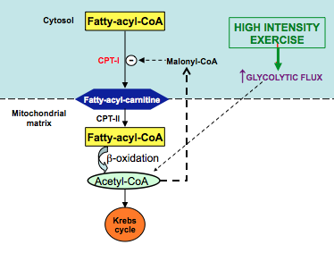
Pathway that Blocks Fat Oxidation at High Intensities
Notes:
Sidossis, L., Gastaldelli, A., Klein, S., & Wolfe, R. Regulation of plasma fatty acid oxidation during low- and high-intensity exercise. American Journal of Physiology- Endocrinology and Metabolism. 1997; 272(6): 1065-70.

Slide 29
Insulin

Slide 30
Glycogenesis is Regulated by Hormones and Metabolites
What would be the benefit of positive regulation of glycogen synthesis by Glucose-6-Phosphate?
Why do you think liver and glycogen isoforms are regulated differently?
Notes:
Hypoglycemia
Ketosis
Failure to thrive

Slide 31
In muscle what else could cause increases in Glucose-6-phosphate levels?
Insulin stimulation of glucose transport
Insulin stimulation of glycolysis
Insulin stimulation of pentose phosphate
Insulin stimulation of gluconeogenesis
Notes:
A

Slide 32
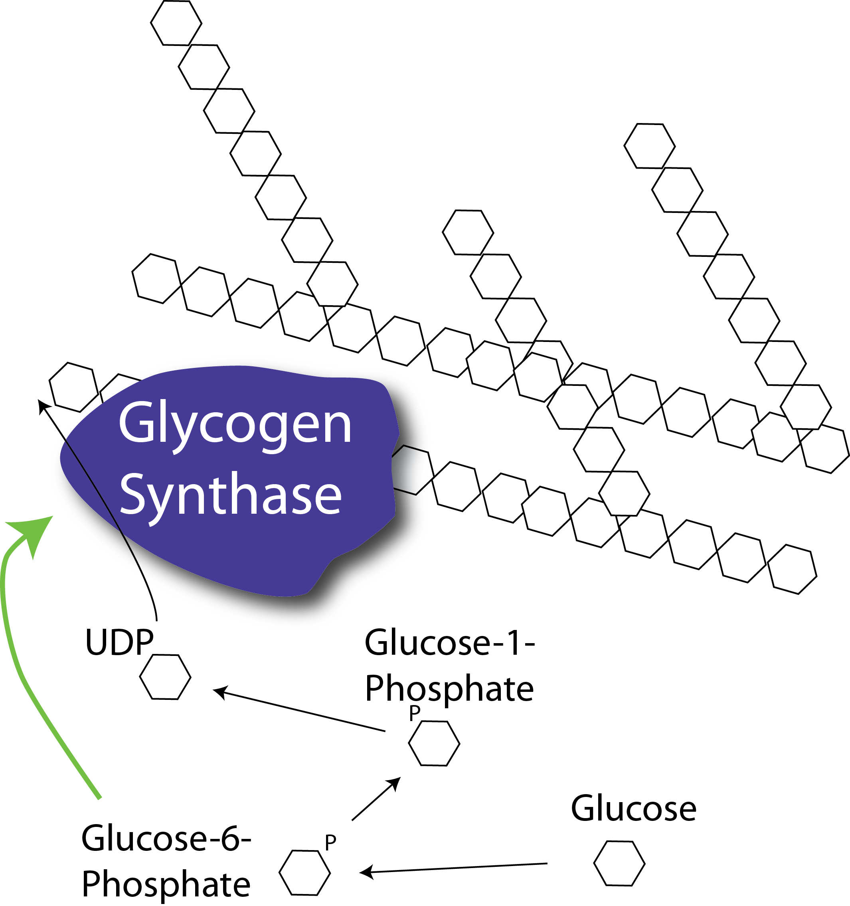
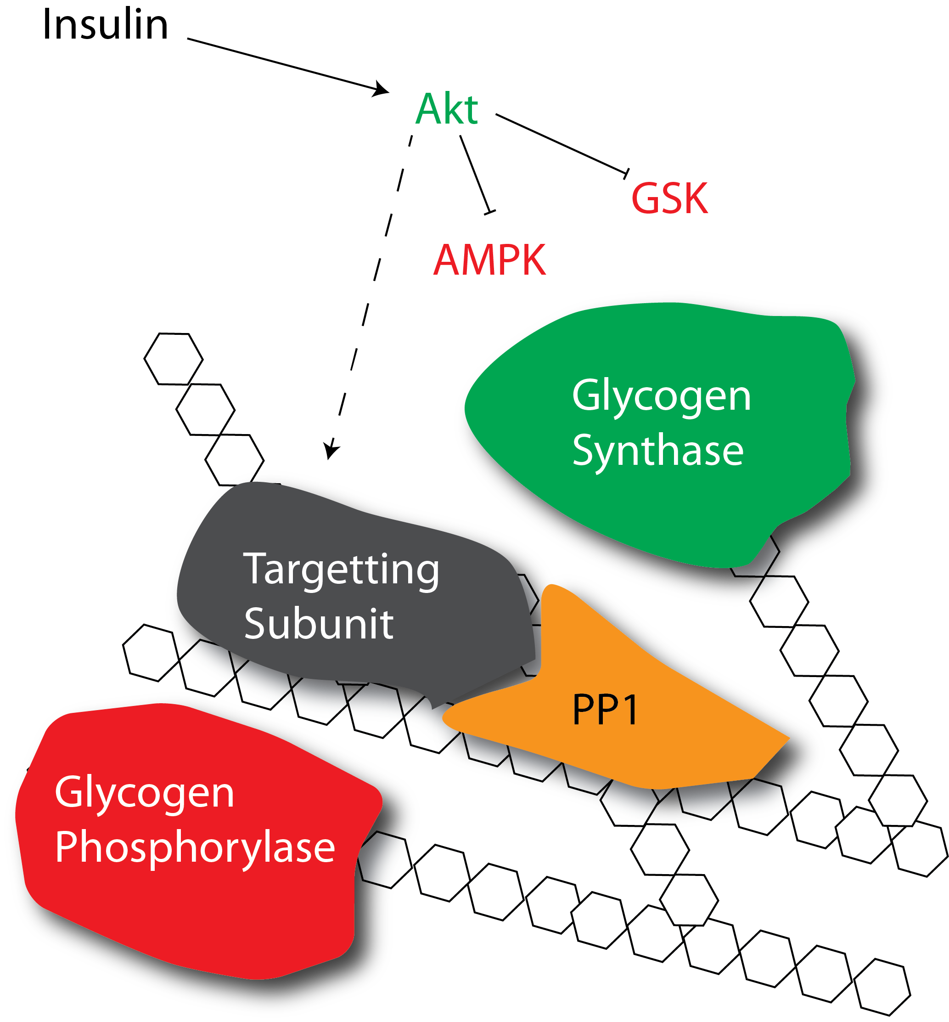
How does insulin promote glycogenesis?
Allosteric activation
Protein dephosphorylation
Notes:
First ask about which mediators are increased with insulin, or see what the allosteric activation of GS looks like

Slide 34
Glycogen storage has limited feedback to suppress glycogenesis
Glycogen supercompensation

Slide 35
How to achieve glycogen supercompensation?
Solid bars glycogen depleted first
Clear bars untrained
Glycogen depleting exercise activity
Large carbohydrate rich meal and rest
Exercise again within 24-48h
At your table: What things do you think would improve the ability to supercompensate glycogen levels?
Nakatani, A. et al. Effect of endurance exercise training on muscle glycogen supercompensation in rats. J. Appl. Physiol. 82, 711–715 (1997).
Notes:
Insulin sensitivity
More muscle mass
Previous training
Less stress, more sleep

Slide 36
Energetic Costs of Storing Glucose as Glycogen
1 ATP at hexokinase/glucokinase step
1 UTP (equivalent to 1 ATP) at the Uridyltransferase step:
Therefore 2 ATP are needed per glucose. This is metabolically inefficient
If lactate -> glucose -> glycogen is 6 ATP/glucose because 4 ATP are used in the Cori cycle
If you store glycogen after a meal, which component of energy expenditure would this be?
Notes:
Oliver garden chicken alfredo has 95g of CHO
0.527 moles
In terms of ATP that is 1.05 moles of ATP x 12 kcal/mol so this is about 24 Calories are needed to store that much glycogen
Body has about 500g of stored glycogen so that would be about 66 Calories to store it all again.

Slide 37
Learning Objectives
Evaluate how the structure of glycogen allows for compact but accessible storage of glucose molecules.
Understand how glycogen synthesis and glycolysis are regulated by intracellular metabolites.
Explain how protein phosphorylation regulates glycogen synthase and glycogen phosphorylase activities and how extracellular signals affect glycogen metabolism.
Assess the tissue-specific roles of insulin, adrenaline and glucagon in glycogen storage.
Distinguish between the functions of glycogen in liver, adipose and muscle and evaluate how alterations in glycogen metabolism affect the physiological functions of these tissues.
Explain how glycogen storage diseases can occur and how specific genes result in different pathophysiologies depending on both the gene, and tissue where it is expressed.

